Slide 1
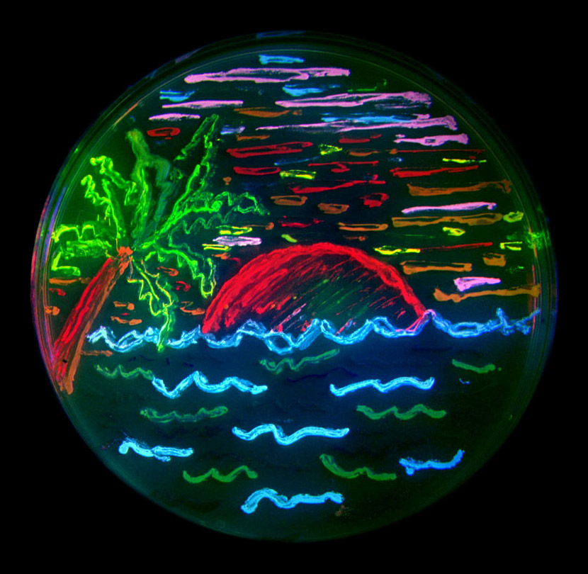

Slide 2
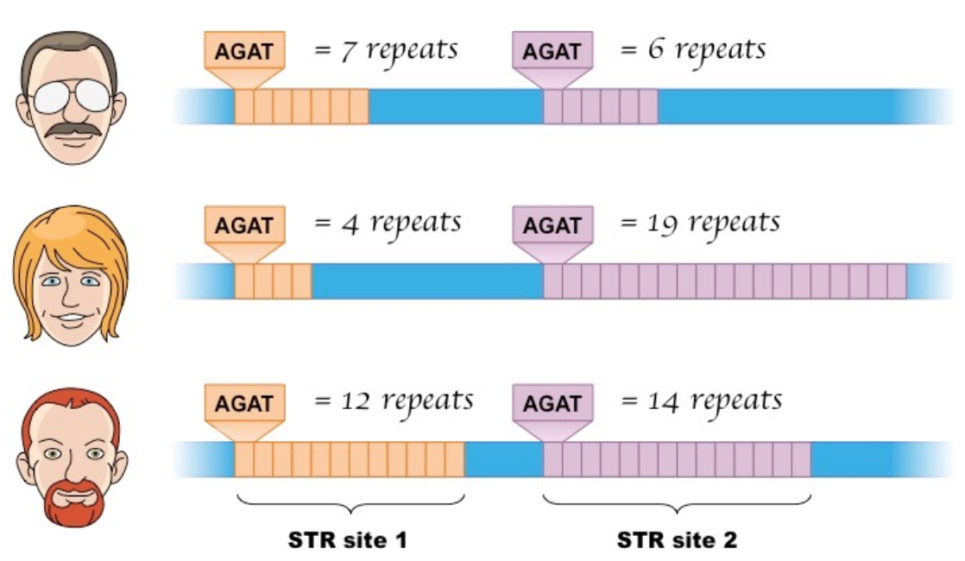
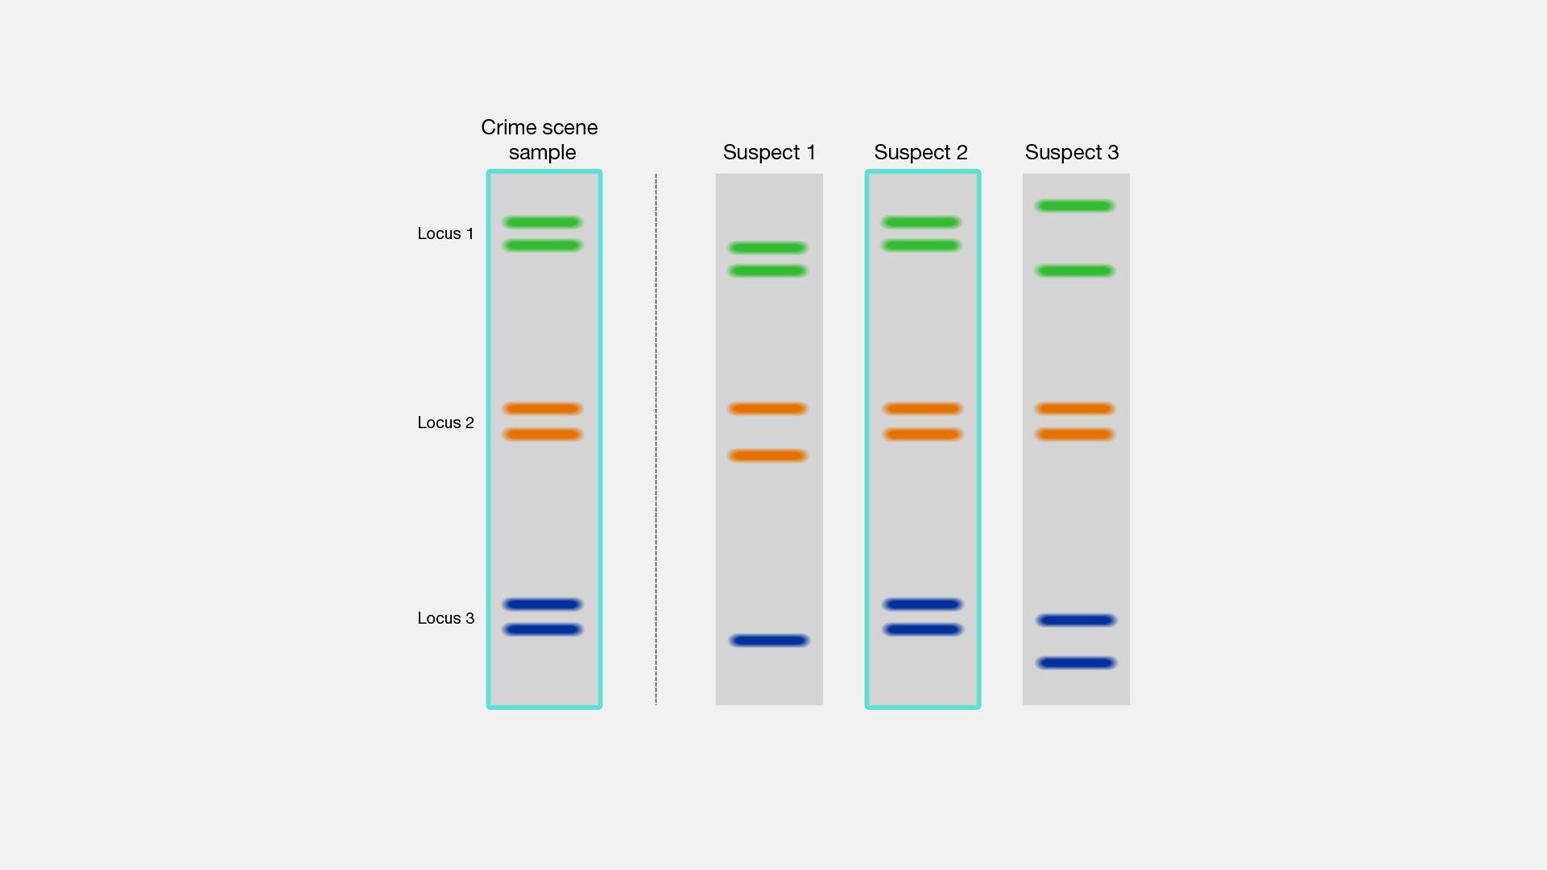
Forensics!!
DNA Fingerprinting:
shows variations in the length of restriction fragments produced by a given restriction enzyme.
Length of repetitive DNA
Golden State Killer : Man in the Window podcast
Notes:
mtDNA used when biological evidence is degraded or in small quantities (only hairs, bones, teeth)
911 incident used mtDNA to identify bodies and get remains back to their families

Slide 3
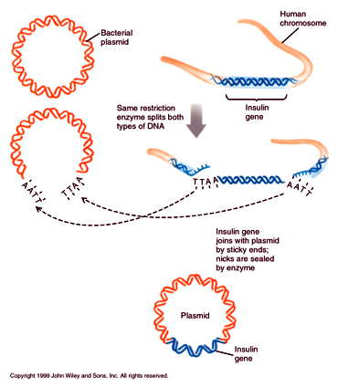
http://www.dnai.org/lesson/go/19436/15737

Slide 4
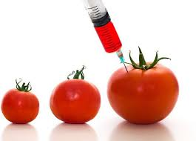
Genetically Modified Organisms (GMOs)
An organism whose genetic material has been altered in a way that does not occur naturally by mating and/or natural recombination
GMOs do the following:
Increase yield
Save on land
Better tasting fruit and veggies (less seeds, more juice, etc.)
Use less pesticides
Add nutritional value
Neil deGrasse Tyson on GMOs: https://www.youtube.com/watch?time_continue=5&v=1ecT2CaL7NA
In over 2,000 independently funded studies, no one has yet detected any allergy, harm, or risk to humans, animals, or the environment from commercialized GM crops.
Notes:
Golden Rice- Rice with beta-carotene (vitamin A) added
Bt Corn- Corn with a bacterial chemical added that is toxic to insects but not humans

Slide 5
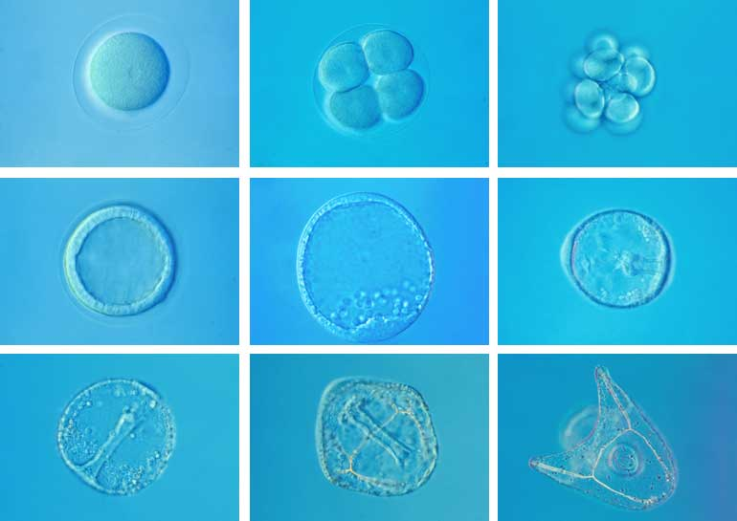
Sea Urchin Development

Slide 6
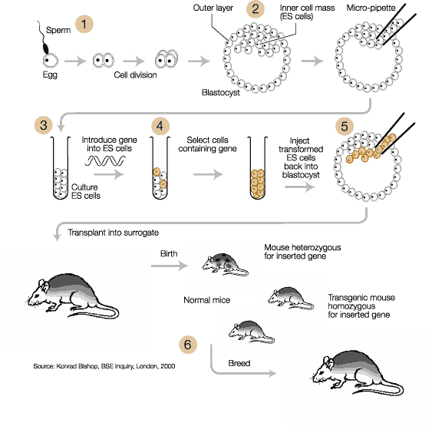

Slide 7
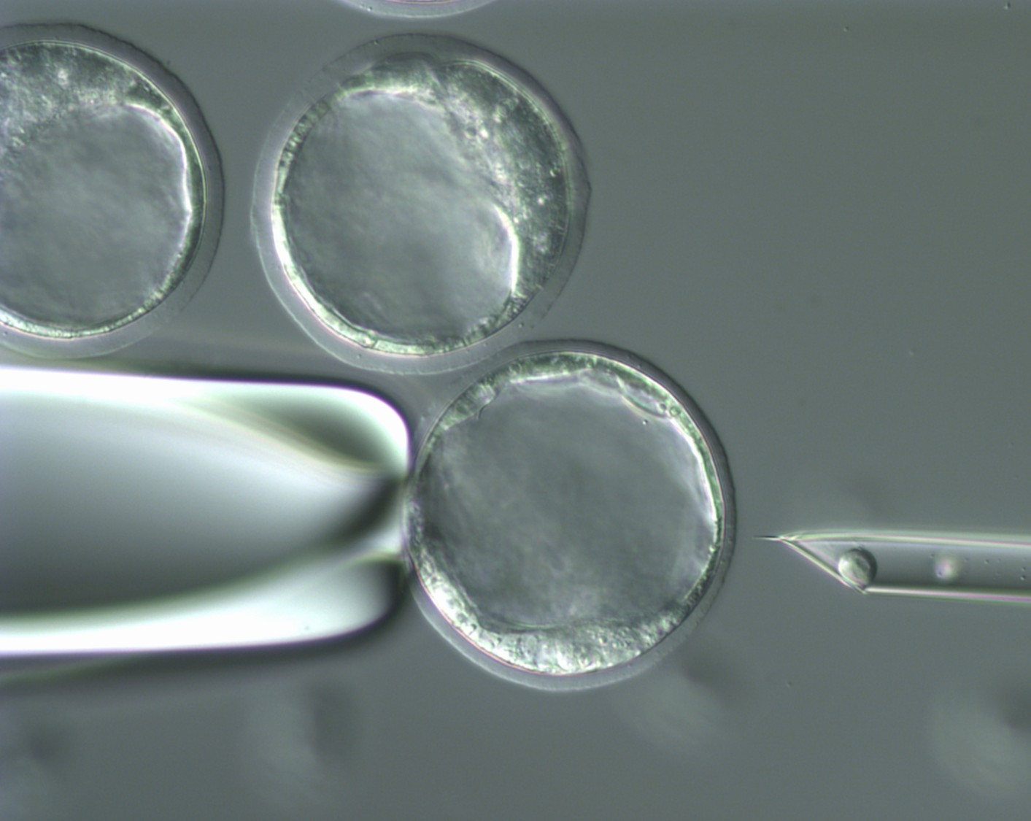

Slide 8
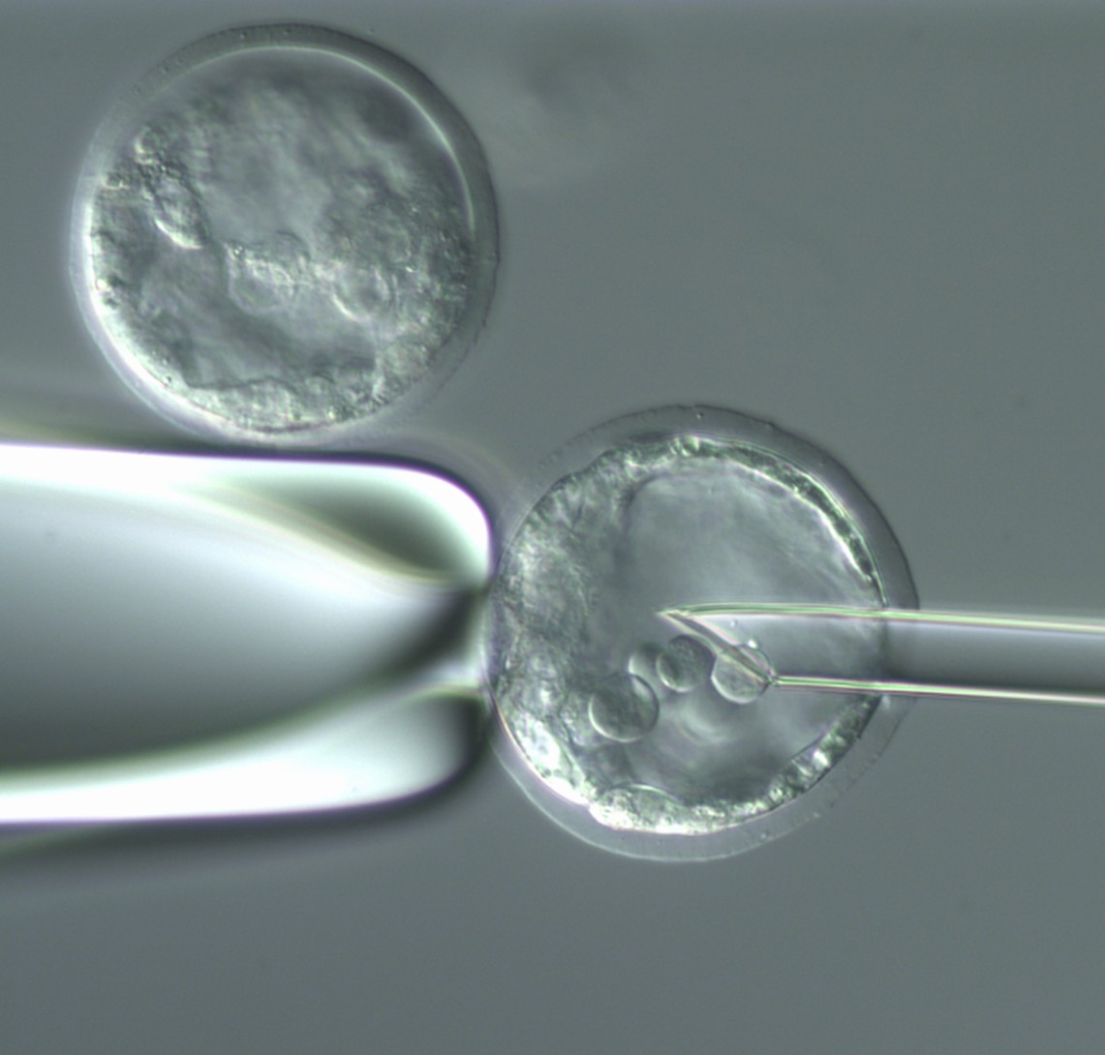

Slide 9
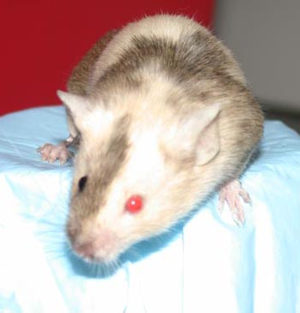

Slide 10
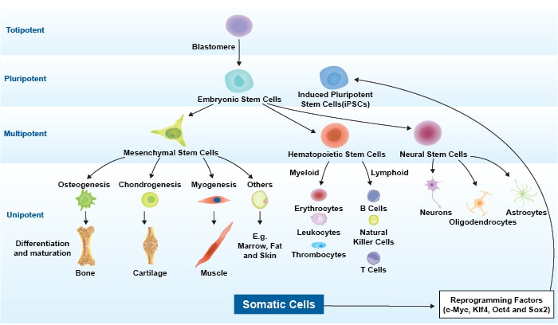
STEM CELLS

Slide 11
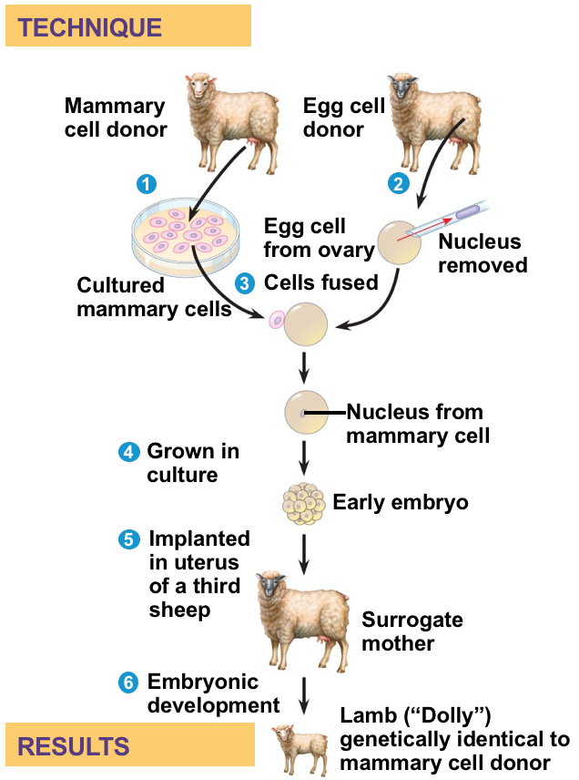
Whole Animal Cloning by nuclear transplantation
Clone your pet:
https://viagenpets.com/dog-cloning/
http://www.myfriendagain.com/
Notes:
Since 1997, cloning has been demonstrated in many mammals, including mice, cats, cows, horses, mules, pigs, and dogs. Problems often arise due to changes on the DNA (methylation, acetylation) which isn’t as easy to duplicate.
Dolly was euthanised because she had a progressive lung disease and severe arthritis. A Finn Dorset such as Dolly has a life expectancy of around 11 to 12 years, butDolly lived 6.5 years.
Cloning uses nucleus from preexisting somatic cell rather than a sperm cell

Slide 12
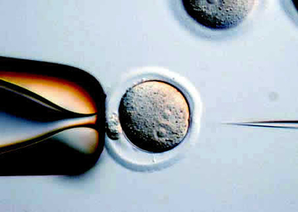

Slide 13
What are gene therapy, cell therapy, and gene editing?
https://www.youtube.com/watch?v=aO4-KFEz8NE
Gene Therapy is the introduction, removal or change in genetic material in the cells of a patient to treat an inherited or developed disease.
Cell Therapy is the transfer of cells into a patient with the goal of improving a disease.
Gene Editing is to removal, disruption or correction of faulty elements of DNA within the gene rather than replacing the gene as regular gene therapy would.

Slide 14
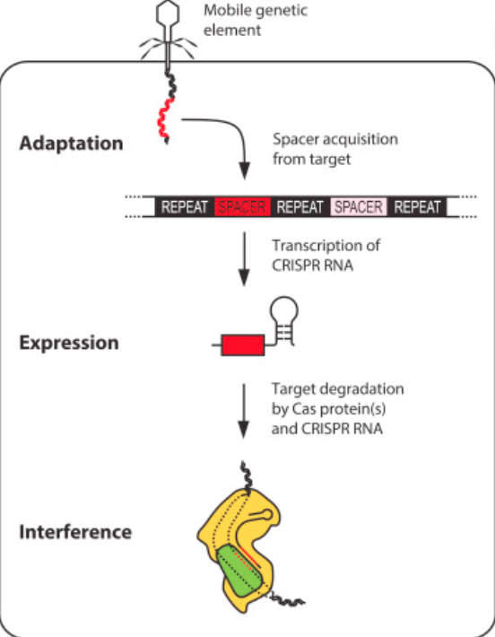
Gene Editing with CRISPR
Discovered as a part of the prokaryotic immune system
Can make actual changes to the genome
Gene editing with CRISPR involves two main parts:
Cas9 – an enzyme that cuts DNA
Guide RNA – a mechanism to get Cas9 to the correct place in the genome
https://www.youtube.com/watch?v=UKbrwPL3wXE

Slide 15
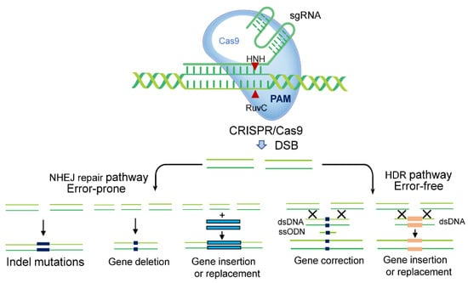

Slide 16
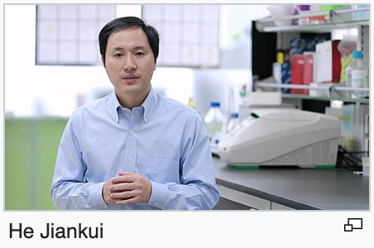
2018 – Chinese CRISPR’d first human embryos
Human embryos injected with CRISPR to eliminate a gene called CCR5 with the aim of making them resistant to HIV.
Ordered CRISPR components from US Biotech companies (violated their “research use only” policies
Found that he also violated Chinese law
Near unanimous condemnation of the work
Immediate moratorium on the implantation of gene-edited embryos
He was fired and all research activities were suspended (uncertain fate as he awaits possible official criminal charges)
Recruited patients by offering free standard IVF services. Man had to be HIV-positive and the woman had to be uninfected.
Notes:
Edited eggs:
“Even if the modifications are verified, the procedure was irresponsible and failed to conform with international norms,” the statement noted. Its flaws included “an inadequate medical indication, a poorly designed study protocol, a failure to meet ethical standards for protecting the welfare of research subjects, and a lack of transparency in the development, review, and conduct of the clinical procedures.”
As of 28 December 2018, He is sequestered in a university apartment, under some sort of surveillance,^{[12][13]} and may face serious consequences.^{[14]} In February 2019, news was reported that suggested the Chinese government may have helped fund the CRISPR babies experiment, at least in part, based on newly uncovered documents.^{[15][16][17]}

Slide 17
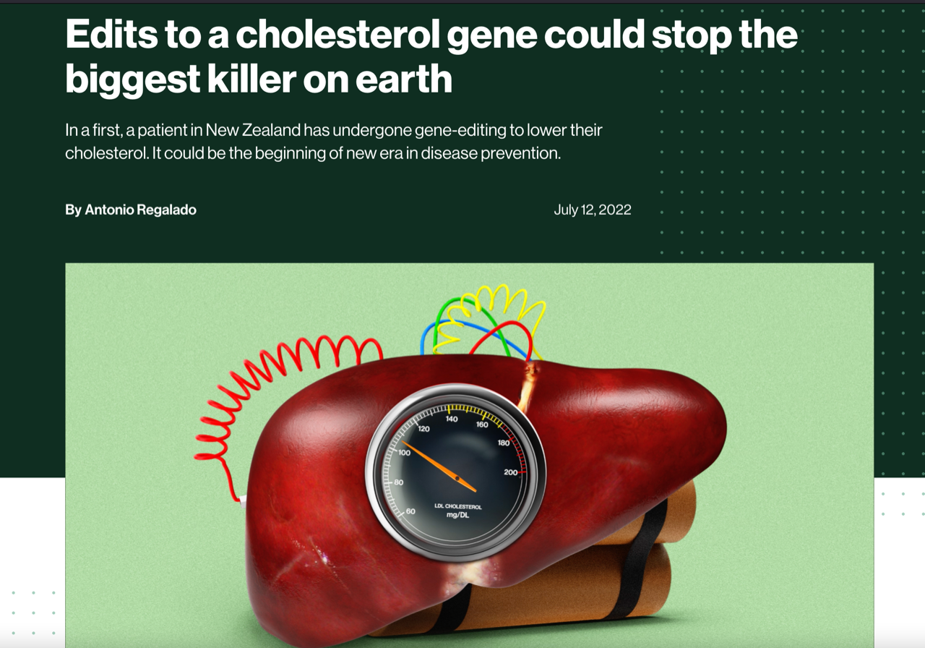
https://www.youtube.com/watch?v=wgui4s8V0eE

Slide 18
More CRISPR resources and movies:
Nature video CRISPR: gene editing and beyond: https://www.youtube.com/watch?v=4YKFw2KZA5o
MIT: quick introduction to CRISPR-Cas9 and guide RNAs: https://www.technologyreview.com/video/608474/crispr-decoded/
Unnatural Selection: Netflix Trailer: https://www.youtube.com/watch?v=WIIVh7H6nvI
WIRED: CRISPR at increasing levels of complexity: https://www.wired.com/video/watch/biologist-explains-one-concept-in-5-levels-of-difficulty-crispr?_ga=2.202749521.1910611492.1575573836-524209113.1575573836
iBiology: Jennifer Doudna: https://www.ibiology.org/genetics-and-gene-regulation/crispr-cas9/
TEDtalk: What you need to know about CRISPR: https://www.ibiology.org/genetics-and-gene-regulation/crispr-cas9/
Mr. Anderson: CRISPR: https://www.youtube.com/watch?v=MnYppmstxIs
Salk: Targeting RNA with CRISPR: https://www.youtube.com/watch?v=hW8aLHiBD-I

Slide 19
PBS CRISPR Videos
CRISPR introduction: https://www.youtube.com/watch?v=_pGNM9CTLJg
CRISPR - how far should we go: https://www.youtube.com/watch?v=wnlJ6dRfPFg&feature=youtu.be

